Slide 1
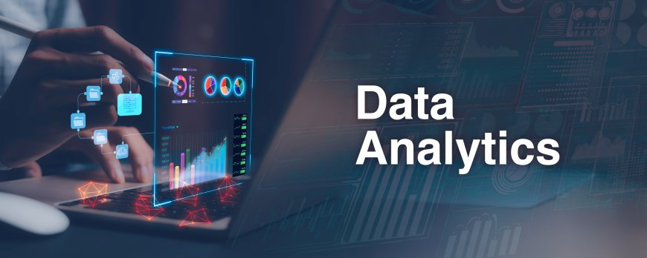
D-Mart Sales Dashboard – Power BI Project
Sales Performance Analysis and Insights

Slide 2
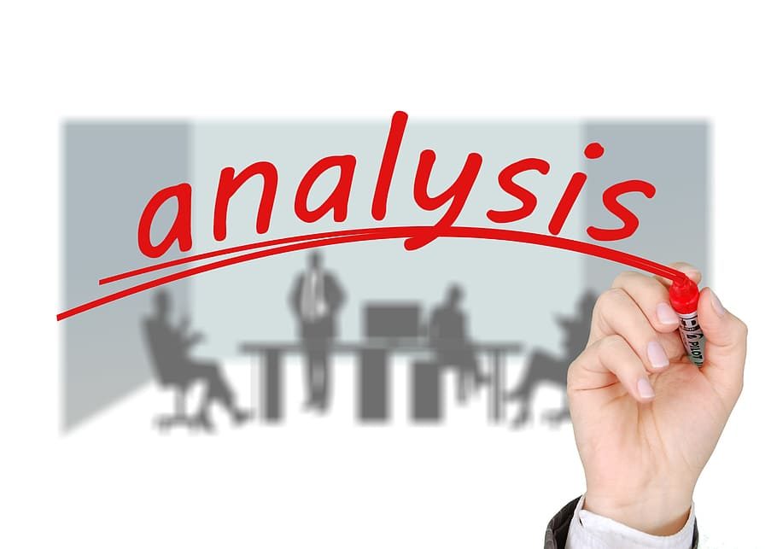
D-Mart transactional data
Date
Customer Type (Member, Premium, Regular)
Product Category (Electronics, Clothing, etc.)
Unit Price
Quantity
Total (Sales Amount)
Time
Transactions
Average Price

Slide 3
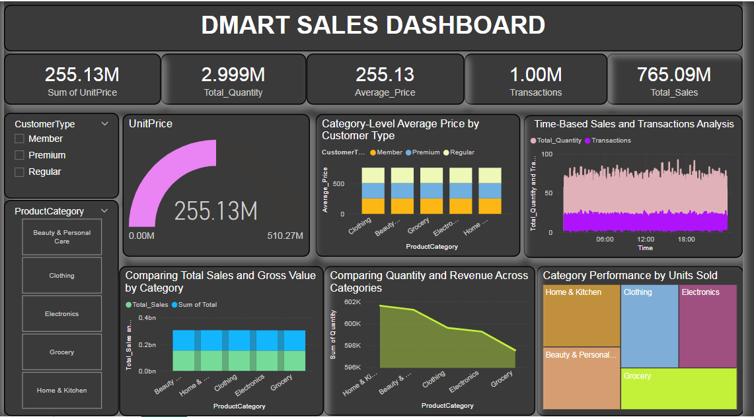

Slide 4
Customer Type Trends
Customer segmentation into Member, Premium, and Regular.
Average prices vary across Product Categories and Customer Types:
Premium customers consistently pay higher across all categories.
Regular customers show more uniform average pricing.

Slide 5
Category Performance
Home & Kitchen and Clothing are the top-performing categories by units sold.
Electronics shows high revenue contribution despite fewer units sold—indicating high-value items.
Grocery has lower average pricing and contributes less to revenue but moves large quantities.

Slide 6
time-Based Analysis
Transactions and sales are consistent throughout the day, with minor peaks around midday and evening.
Suggests strong day-long footfall or online engagement.

Slide 7
Sales vs Quantity Comparison
Beauty & Personal Care and Electronics have a higher total sales value relative to quantity—indicating higher priced items.
Home & Kitchen and Grocery have high volumes but moderate revenue—likely due to essential/low-cost items.

Slide 8
Actionable Takeaways
Focus marketing on Premium customers in high-value categories (Electronics, Clothing).
Consider bundling or promotions in Grocery to drive higher ticket sizes.
Optimize stock and staffing for midday and evening peak hours.

Slide 9
Conclusion
The DMart Sales Dashboard provides a comprehensive overview of sales, customer behavior, and product category performance. Key insights show that:
High-value categories like Electronics and Clothing contribute significantly to revenue, especially from Premium customers.
Home & Kitchen and Grocery lead in volume sold, indicating strong demand for essential products.
Time-based patterns reveal steady sales throughout the day with minor peaks, which can help in optimizing operations and marketing.

